Slide 1
TECH GESTURE SPEAK - using Arduino

Slide 2
Prof. Divya Meena Sundaram
ECS ID : 240620
Team Members :
21MIS7005 – Krishna Mohan
21MIS7012 – Lakshman Rohit
21MIS7015 – Praneetha
21MIS7022 – Madhu Sudhan
21MIS7039 – Kaarthikeya
21MIS7087 – Nikhilesh

Slide 3
Tech Gesture Speak
The "Sign Language Glove" aims to provide an innovative solution for individuals with hearing or speech impairments. This project focuses on creating a wearable glove that interprets hand gestures used in sign language and translates them into text displayed on an LCD screen. The technology is simple, cost-effective, and could dramatically improve communication for users in real-time without relying on an interpreter.
The glove aims to overcome communication barriers, making it easier for people who cannot hear or speak to communicate with others who don't understand sign language. This solution is particularly useful in environments like hospitals, schools, or public spaces where accessibility is often limited.

Slide 4
Components
Arduino - 1
Flex sensors - 5
Df Mini Player - 1
Speaker – 1
Zero PCB - 1

Slide 5
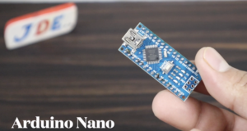
Arduino Nano
We utilized the Arduino Nano microcontroller for this project due to its compact size. The Arduino Nano's operating voltage is 5v, and the Flex Sensor also operates at 5v, which is why we chose this microcontroller. The Arduino Nano microcontroller features Pin Conviction. We used 5 flex sensors, and all sensors received Analogue output from the Arduino Nano via the built-in 8 Analogue pins (A0-A8).
Alternatives: Other microcontrollers, such as the Arduino Uno and ESP32, were investigated. However, the Arduino Nano's smaller size and enough performance made it the favored option.

Slide 6
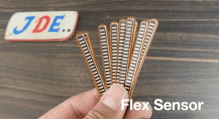
Flex Sensor
A flex sensor is a resistive device whose resistance changes depending on how far it is bent. It is made of a flexible polymer with conductive components that change resistance as the sensor bends, much like a variable resistor. The sensor contains two leads, and the resistance changes as the voltage across them varies. It runs at 0-5V and has a flat resistance of around 25K ohms.
Alternatives Considered: While strain gauges and potentiometers may also detect bending or rotation, flex sensors provide a more compact and versatile option that meets the project's criteria.

Slide 7
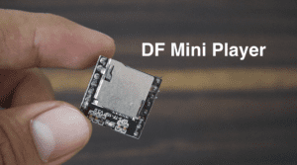
Df Mini Player
The DF Mini Player is an audio module that plays MP3, WAV, and WMA files from a microSD card, with an internal amplifier and a 3.5mm audio jack for speakers. Controlled via a serial interface, it's compatible with Arduino and other microcontrollers. It supports UART connection, operates at 3.5V-5V, and connects VCC to Arduino's 5V, GND to GND, Rx to D10, and Tx to D9.
Alternatives: Other audio playback devices or digital audio converters were examined. However, the DFPlayer Mini's ease of use and compatibility with Arduino made it the favoured option.

Slide 8
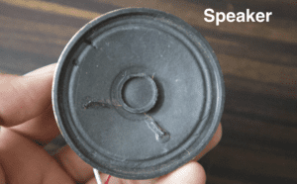
Speaker
In this Project, we used the 8 Ohm / 0.25 watt Speaker and the sound of the speaker is relay clear and proper way sound.

Slide 9
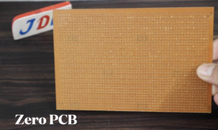
Zero PCB
In this Project we used the 4×4 zero PCB is Used to Build The Prototypes or Testing Of Any Project.
On the Back Side Of the Zero PCB, You Sold all the components.

Slide 10
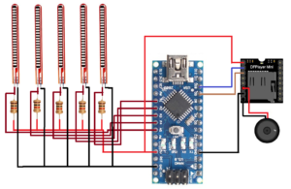
Circuit diagram

Slide 11
Process
Flex Sensors:
Connection to Arduino Analog Pins:
Each flex sensor has two leads, one to a resistor and the other to the Arduino's analogue input pin (A0, A1, A2, A3, and A4). These analogue pins measure the fluctuating resistance of the flex sensors as they bend.
Resistors: Resistors are connected in series with each sensor to limit current and stabilize readings.
Ground Connection: The other side of the resistors is connected to common ground (GND).

Slide 12
Arduino Nano:
Power Supply (VCC & GND): The Arduino Nano's VCC pin is connected to a 5V power source, while the GND pin is connected to ground. This powers the entire circuit.
Analogue Inputs (A0-A4): The flex sensors are linked to the Arduino's analogue input pins A0 through A4. The Arduino will read voltage fluctuations caused by the flex sensor's bending and transform them into digital signals for processing.
DFPlayer Mini:
Power Supply:
The VCC pin of the DFPlayer Mini is connected to the Arduino’s 5V pin to power the module.
The GND pin is connected to the Arduino’s ground (GND).

Slide 13
Serial Communication:
The DFPlayer Mini's Rx (receive) pin is connected to digital pin D10 of the Arduino, while the Tx (transmit) pin is connected to digital pin D9 of the Arduino. These connections enable serial communication between the Arduino and the DFPlayer, allowing the Arduino to send orders to control audio file playback.
MicroSD Card:
The DFPlayer Mini has a microSD card slot where audio files (MP3/WAV) are stored. In the Arduino code, the audio files can be referenced using their names or index numbers.
Speaker:
Connection to DFPlayer Mini: The DFPlayer Mini includes an amplifier and audio output pins. The speaker is connected to these output pins so that when the corresponding gesture is recognised, the Arduino sends the order to play the audio file.

Slide 14
System Functions
The flex sensors detect the bending of each finger and relay resistance readings to the Arduino.
The Arduino processes these values and identifies the gesture.
Once the gesture is identified, the Arduino sends a command to the DFPlayer Mini via UART (serial communication) to play a specific audio file stored on the microSD card.
The DFPlayer Mini then outputs the audio to the speaker, which plays the corresponding sound or speech.
This configuration enables the system to transform finger motions into audio, making it suitable for applications such as sign language to voice translation.

Slide 15
THANK YOU MADAM

